Slide 1
Object-oriented model with UML III (Sequence diagram)
Zhang Jinyu – zjy@bjtu.edu.ch
School of Computer and Information Technology
SD 408

Slide 2
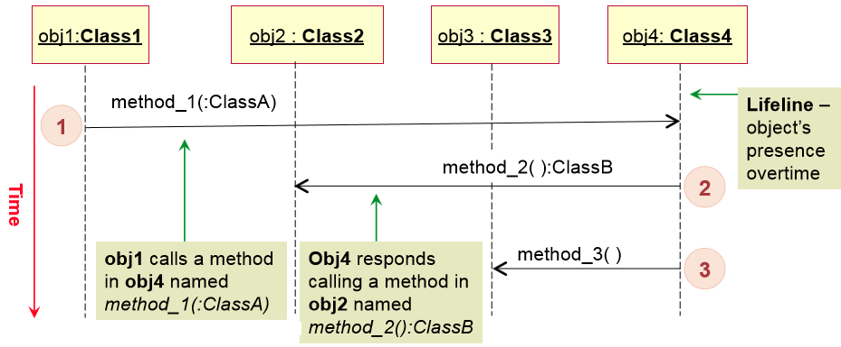
Sequence diagrams
序列图捕获了在单一场景中开发的系统的行为。
它显示了场景中许多对象和在这些对象之间传递的消息
A sequence diagram captures the behavior of the system being developed in a single scenario.
It show a number of objects and the messages that are passed between these objects in the scenario
USE CASE

Slide 3
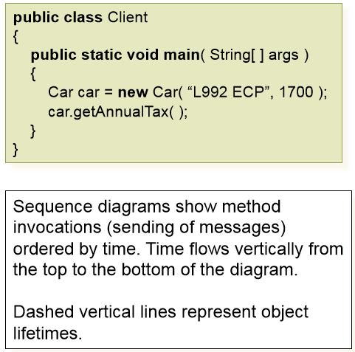
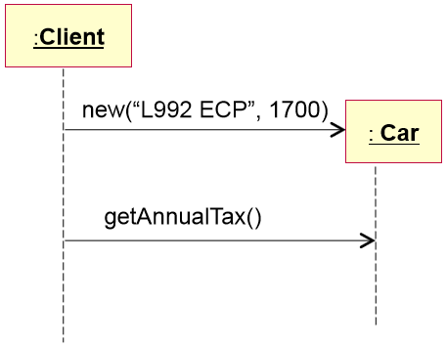
Sequence diagrams – code example
序列图显示了按时间顺序的方法调用(消息的发送)。
时间从图表的顶部到底部垂直流动。
破折线

Slide 4
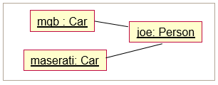
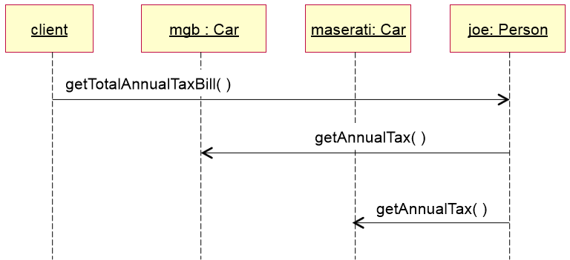
Sequence diagrams

Slide 5
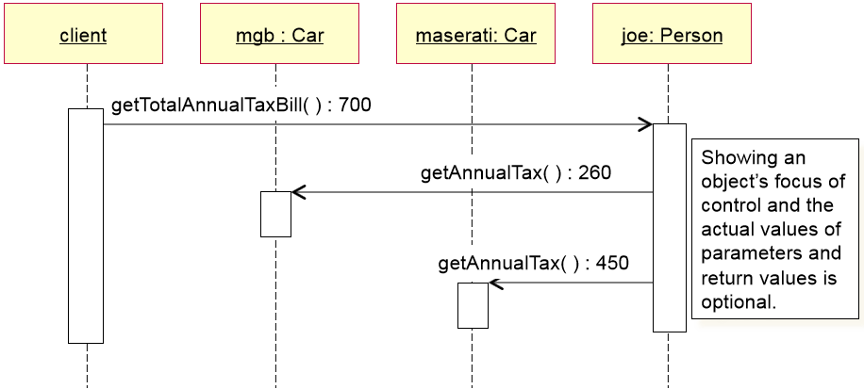

Slide 6
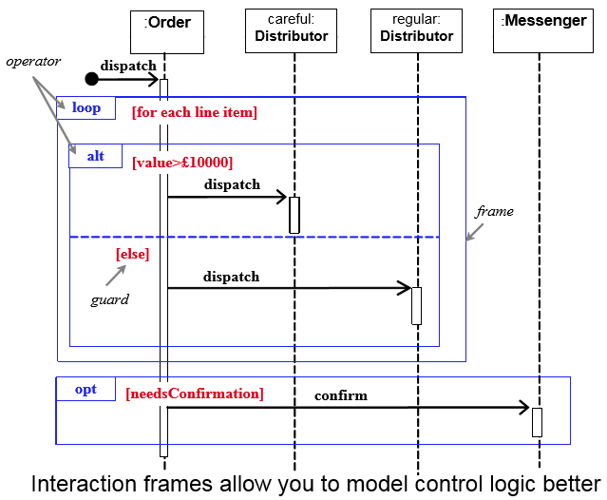
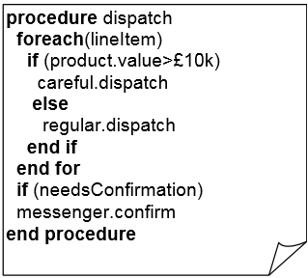
Interaction frames
发货

Slide 7
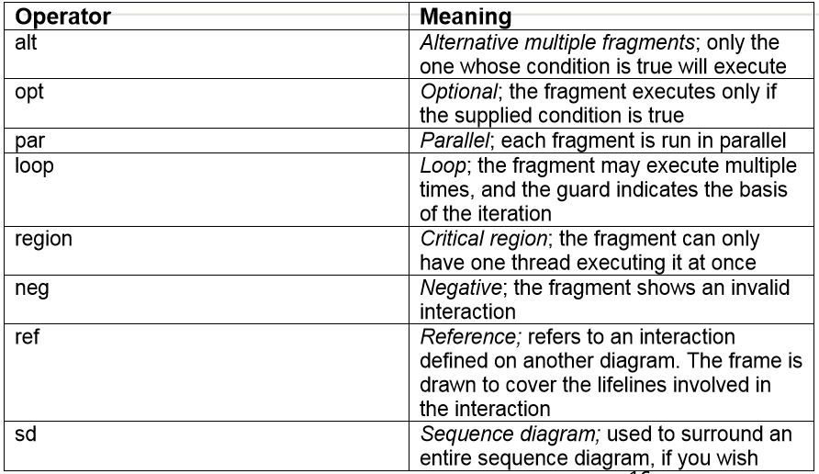
Common Operators for interaction frames

Slide 8
Guidelines for drawing Sequence Diagrams
Identify the instances of the classes that participate in the sequence
Establish the sequence of method calls
对象
3. Draw the instances at top of the page from left to right as shown
:Class1
: Class2
: Class3
: Class4
Add method calls starting with the first call on the top left.
Use frames to show alternative, optional, and loop fragments
:Class1
: Class2
: Class3
: Class4
method_1(:Class):Class
1
method_2( ):Class
2
method_3( )
3

Slide 9
Sequence diagram example

Slide 10
SecureHome System example
Consider a security system called SecureHome that comprises of a keypad and LCD display for interacting with the user, a siren, an entry sensor, a motion sensor and a smoke sensor.
During installation, the keypad is used to configure the system. Each sensor is assigned a unique number, type and location. A 4-digit PIN is input into the system for arming and disarming SecureHome.
When a sensor event is detected by the system, it turns on the siren. The system then waits for 20 sec and sends a text message to the home owner with information about the nature and location of the sensor event.
The message is re-sent every 20 seconds until an acknowledgement is received.
_________________________________
Develop a class diagram for the SecureHome system.
Draw a sequence diagram showing what happens when the smoke sensor is triggered
考试题类型

Slide 11
Siren
报警器
Messenger
Keypad
status: boolean
是否报警
phoneNo: int
command: String
turnOn()
turnOff()
text(:int, :String): boolean
input(:String)
activates
uses
Sensor
SystemManager
Id: int
iocation: String
notifies
inputs commands
密码
pin: int
armStatus: boolean
homeAddress: String
monitoringServicePhone: int
setLocation(:String)
getLocation():String
triggered()
displays messages
configures
arm(:int)
disarm(:int)
configure()
sensorEvent(:int, :String)
LCD Display
传感器
message: String
Entry
Motion
Smoke
display(:String)
clear()
entryTriggerLevel:int
motionTriggerLevel:int
smokeTriggerLevel:int
setEntryTrigLevel(:int)
setMotionTrigLevel(:int)
setSmokeTrigLevel(:int)
Draw a sequence diagram showing what happens when the smoke sensor is triggered

Slide 12
Siren
Messenger
Keypad
status: boolean
phoneNo: int
command: String
turnOn()
turnOff()
text(:int, :String): boolean
input(:String)
activates
uses
Sensor
SystemManager
Id: int
iocation: String
notifies
inputs commands
pin: int
armStatus: boolean
homeAddress: String
monitoringServicePhone: int
setLocation(:String)
getLocation():String
triggered()
displays messages
configures
arm(:int)
disarm(:int)
configure()
sensorEvent(:int, :String)
LCD Display
message: String
Entry
Motion
Smoke
display(:String)
clear()
entryTriggerLevel:int
motionTriggerLevel:int
smokeTriggerLevel:int
setEntryTrigLevel(:int)
setMotionTrigLevel(:int)
setSmokeTrigLevel(:int)
Draw a sequence diagram showing what happens when the smoke sensor is triggered

Slide 13
Siren
Messenger
Keypad
status: boolean
phoneNo: int
command: String
turnOn()
turnOff()
text(:int, :String): boolean
input(:String)
2
activates
uses
3
Sensor
SystemManager
1
Id: int
iocation: String
notifies
inputs commands
pin: int
armStatus: boolean
homeAddress: String
monitoringServicePhone: int
setLocation(:String)
getLocation():String
triggered()
displays messages
configures
arm(:int)
disarm(:int)
configure()
sensorEvent(:int, :String)
LCD Display
message: String
Entry
Motion
Smoke
display(:String)
clear()
entryTriggerLevel:int
motionTriggerLevel:int
smokeTriggerLevel:int
setEntryTrigLevel(:int)
setMotionTrigLevel(:int)
setSmokeTrigLevel(:int)
Draw a sequence diagram showing what happens when the smoke sensor is triggered

Slide 14
Sequence diagram for SecureHome
:Smoke
:SystemManager
:Siren
:Messenger
sensorEvent(:int, :String)
turnOn()
text(:int, :String):boolean
The message is re-sent every 20 seconds until an acknowledgement is received.

Slide 15
Sequence diagram for SecureHome
:Smoke
:SystemManager
:Siren
:Messenger
sensorEvent(:int, :String)
turnOn()
Loop
[while acknowledge == false && wait ≥ 20sec]
text(:int, :String):boolean
The message is re-sent every 20 seconds until an acknowledgement is received.

Slide 16
Question？

